Slide 1
Intelligent Systems
Litty Tressa George
Lecturer FICT
Section 1 PPT 1

Slide 2
CONTENTS
AI Paradigms
Knowledge Representation Fundamentals
Knowledge Representation Techniques
Logical Reasoning

Slide 3
Symbolic AI Vs Nonsymbolic AI
Symbolic AI
Symbolic artificial intelligence, also known as Good, Old-Fashioned AI , was the dominant paradigm in the AI
Implementations of symbolic reasoning are called rules engines or expert systems or knowledge graphs.
These systems are essentially heaps of nested if-then statements drawing conclusions about entities (human-readable concepts) and their relations (expressed in well understood semantics like X is-a man or X lives-in America)
The symbolic approach says that the best way to teach an AI is to feed it human-readable information related to what you think it needs to know. If you want to create an AI to replace a doctor, you feed it a ton of medical textbooks and it answers questions by looking up the answers from those textbooks.

Slide 4
Consider the Example case - You want to translate a phrase from English to Chinese. You send your English phrase on a note under the door to the man in the room, and he is meant to translate it to Chinese and slip your answer out as soon as he’s done
Symbolic AI Example: If the man were a symbolic AI, he would look at your paper and see that you have an English phrase and want to translate it to Chinese . He’d walk over to the Chinese bookshelves and grab a few Chinese phrasebooks, look up your English phrases and note down the equivalent phrases in Chinese. After a while, he’ll then slide the translated paper back under the door to you. From your perspective, it looks like the man behind the door knows Chinese, but he actually doesn’t.

Slide 5
Non Symbolic AI
The non symbolic approach admits that human-based information formats aren’t always the best fit for AI, and encourages feeding raw information into the AI and making it learn so that it can analyze and construct its own implicit knowledge about.
Example: If the man behind the door were a nonsymbolic AI, he’d receive the paper under the door, see you want to translate from English to Mandarin, and just write down the translation and immediately send it back.
Non-symbolic AI usually refers to statistic methods including things like artificial neural neural networks, support vector machines etc..

Slide 6
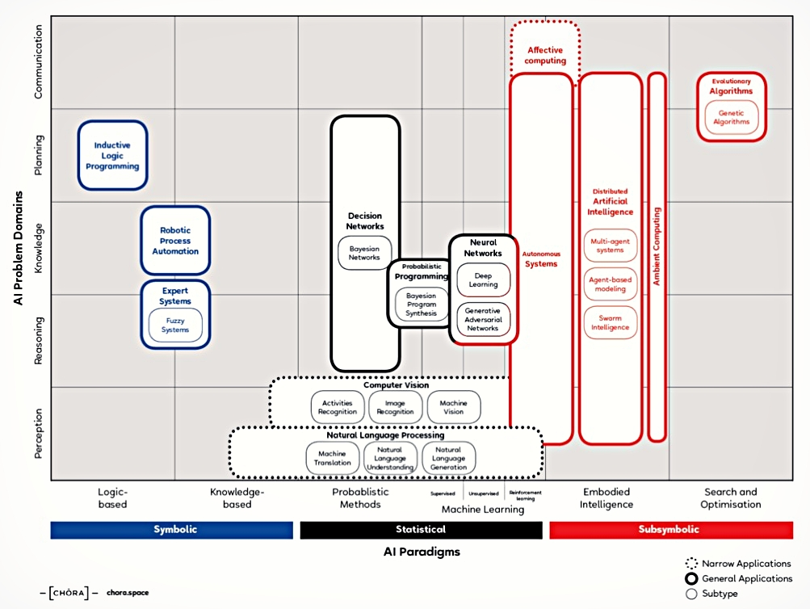

Slide 7
Knowledge Representation Fundamentals

Slide 8
Knowledge & Meta-knowledge
Data is unprocessed facts and figures without any added interpretation or analysis. It is unstructured or raw
Information is data that has been interpreted so that it has meaning for the user. In short, structured/processed data is information.
Metainformation is information about information.
For example, a if a document is considered to be information, its title, location, and subject are examples of metainformation.
Knowledge is a more “processed” version of information.
Meta-knowledge is knowledge about a preselected knowledge. (knowledge about knowledge)
A book on the shelf is information — until a person reads it, understands it, and absorbs it. Then (and only then) it has been converted into that person’s knowledge. (When the person subsequently socializes that knowledge and applies it to make decisions and/or take actions, then it has become intelligence.)

Slide 9
What To Represent ?
Following are the various fields of knowledge which needs to be represented in AI systems.
Object: All the facts about objects in our domain world. E.g., Guitars contains strings, trumpets are brass instruments.
Events: Events are the actions which occur in our domain world.
Performance: It describe behavior which involves knowledge about how to do things. How it respond and act or how efficiently it reacts.
Meta-knowledge: It is knowledge about the all the knowledge that we consider in our domain.
Facts: Facts are the truths about the real world and the domain what we represent.
Knowledge-Base: The central component of the knowledge-based agents is the knowledge base. It is represented as KB. The Knowledgebase is a group of the Sentences (Here, sentences are used as a technical term – (NLP )and not identical with the English language).

Slide 10
Knowledge comes to us in many different forms.
We need knowledge to solve and perform an infinite variety of tasks.
Knowledge can be complexly or simply structured.
Example
Simple knowledge – traffic light sequence
Complex knowledge – expert domain knowledge e.g. brain surgeon

Slide 11
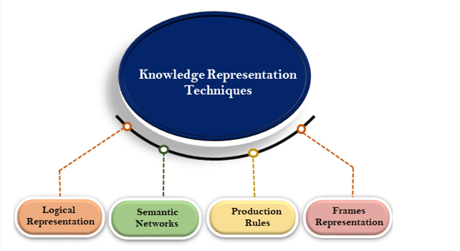
Symbolic Knowledge Representation Techniques

Slide 12
Logical Representation
Propositional Logic
Logic is used to reason about the truth value of statements or propositions
Propositional logic could only represent statements which are either true or false, thus it is also known as ‘Boolean Logic’.
The propositions and connectives are the basic elements of the propositional logic.
Connectives can be said as a logical operator which connects two sentences.
An atomic proposition – or atom – is the smallest entity to which a value of true or false can be assigned.
A proposition formula which is always true is called Tautology, and it is also called a valid sentence.
A proposition formula which is always false is called Contradiction.
Statements which are questions, commands, or opinions are not propositions such as "Where is Sam", "How are you", "What is your name", are not propositions.

Slide 13
Examples of propositions:
Copper is metal
Manchester is a city
Tom is a cat
3+3= 7(False proposition)
Complex sentences can be constructed from 2 or more atomic propositions and can be called as Compound Prepositions
Symbols are used to denote relationships between entities
Logical connectives or operators connect the propositions into sentences of arbitrary size and complexity

Slide 14
Letters used to represent facts about the world, For example:
C = Barry Drinks Coffee
D = Barry Eats Cake
Using these facts and notation we can construct a variety of statements:
C /\ D Barry drinks coffee AND Barry eats cake
C \/ D Barry drinks coffee OR Barry eats cake
¬ C Barry doesn't drink coffee
C → D If Barry drinks coffee then Barry eats cake
C ←→ D D If Barry drinks coffee then Barry eats cake and vice versa

Slide 15
Logical Representation
Predicate Logic /First Order Logic ( FOL)
Unfortunately, in propositional logic, we can only represent the facts, which are either true or false.
PL is not sufficient to represent the complex sentences or natural language statements.
The propositional logic has very limited expressive power.
Predicate Logic is an extension to propositional logic, which is able to represent more information than Prepositional Logic
Consider the following sentence, which we cannot represent using PL logic.
"Some humans are intelligent", or
"Sachin likes cricket.“
To represent the above statements, PL logic is not sufficient, so we required some more powerful logic, such as first-order logic.

Slide 16
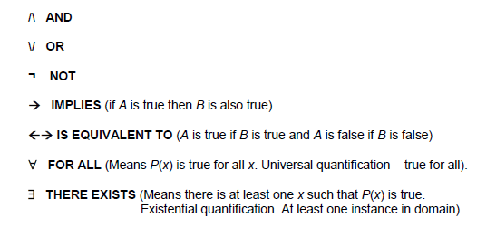
Some Common Symbols And Meanings:
Prepositional Logic
Predicate/FOL logic
PL cannot signify or express the generalization, specialization or pattern for example ‘QUANTIFIERS’ cannot be used in PL but in FOL users can easily use quantifiers as it does express the generalization, specialization, and pattern. (Note: In the above list the last two symbols are called Quantifiers)

Slide 17
Logical statements can include mainly three constituent elements:
• Constants - symbols such as “Barry”
• Variables - symbols denoted by capital letters such as A or X
• Functional expressions - a function followed by a number of arguments
Statements can be joined together using this notation to produce more complex statements.
Example:
Likes (slither, carrots) /\ Likes (slither, cabbage)
So Slither likes carrots and cabbage.
Such statements can be expanded to include greater semantic specificity:

Slide 18
Symbols and meanings:
/\ AND
\/ OR
¬ NOT
→ IMPLIES
←→ IS EQUIVALENT TO
∀ FOR ALL
∃ THERE EXISTS

Slide 20
Production Rules
Production rules system consist of (condition, action) pairs which mean, "If condition then action". It has mainly three parts:
1.The set of production rules
2.Working Memory
3.The recognize-act-cycle
1. In production rules agent/system checks for the condition and if the condition exists then production rule fires and corresponding action is carried out. The condition part of the rule determines which rule may be applied to a problem. And the action part carries out the associated problem-solving steps. This complete process is called a recognize-act cycle.
2. The working memory contains the description of the current state of problems and events which are solving. Rules can write knowledge (update) to the working memory. This knowledge match and may fire other rules.
3. If there is a new situation (state) generates, then multiple production rules will be fired together, this is called conflict set. In this situation, the agent/system needs to select a rule from these sets, and it is called a conflict resolution.

Slide 21
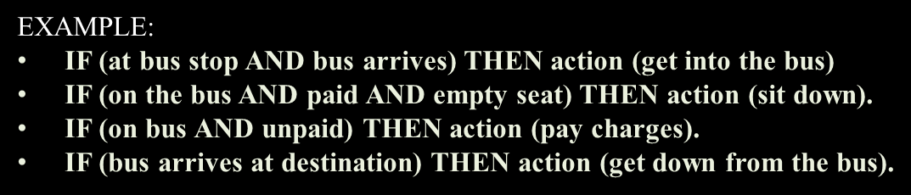
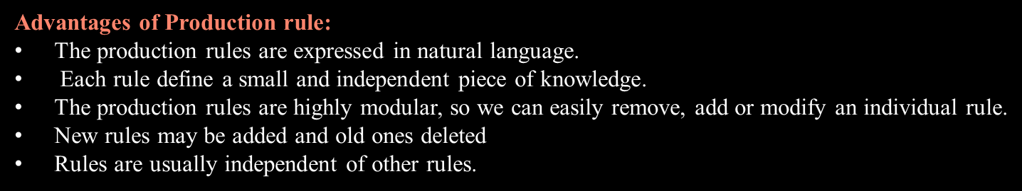

Slide 22
Disadvantages of Production rule:
Production rule system does not exhibit any learning capabilities, as it does not store the result of the problem for the future uses.
During the execution of the program, many rules may be active hence rule-based production systems are inefficient
Note: The production rules as knowledge representation mechanism are used in the design of many "Rule-based systems" also called "Production systems" .

Slide 23
Rule-based Production Systems
Three major types of rules used in the Rule-based production systems.
■ Knowledge Declarative Rules : These rules state all the facts and relationships about a problem. e.g., IF inflation rate declines THEN the price of gold goes down. These rules are a part of the knowledge base.
■ Inference Procedural Rules : These rules advise on how to solve a problem, while certain facts are known. e.g., IF the data needed is not in the system THEN request it from the user. These rules are part of the inference engine.
■ Meta rules : These are rules for making rules. Meta-rules reason about which rules should be considered for firing. e.g., IF the rules which do not mention the current goal in their premise, AND there are rules which do mention the current goal in their premise, THEN the former rule should be used in preference to the latter.
− Meta-rules direct reasoning rather than actually performing reasoning.
− Meta-rules specify which rules should be considered and in which order they should be invoked.

Slide 24
Alternative Knowledge Representations
Alternative representations include:
Semantic nets
Frames
Scripts
Semantic Nets:
These are a graphical way to explain the structure and relationships in a domain of interest. Here, relationships are denoted using links. Certain links, such as ISA or IS-A-KIND-OF, indicate class membership, meaning that an object can inherit features of a superclass. Here bird inherits features of vertebrate.

Slide 25
Semantic Networks
A graphical method to represent knowledge – essentially directed or undirected graphs
Objects denote real-world entities or concepts
These are represented as nodes or vertices in the network
Links or edges between the nodes denote relationships between the objects
They can be used as a tool from which to extract facts and rules that form the basis of a knowledge base
This representation consist of mainly two types of relations:
IS-A relation (Inheritance)
Kind-of- relation

Slide 26
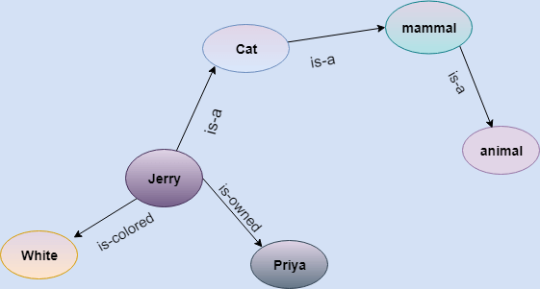
Example: Following are some statements which we need to represent in the form of nodes and arcs.
Statements:
Jerry is a cat.
Jerry is a mammal
Jerry is owned by Priya.
Jerry is white colored.
All Mammals are animal.
In the above diagram, we have represented the different type of knowledge in the form of nodes and arcs. Each object is connected with another object by some relation.

Slide 27
Semantic networks are a powerful and fundamental AI technique for capturing domain semantics and structural relationships.
Relationships are explicitly denoted by arcs or links, or directed and undirected edges
An inference mechanism could make associations between objects by following the connections or links between the objects.
By following the links, such a mechanism could determine that a “bluebird is a type of vertebrate.”

Slide 28
This is more efficient than exhaustively searching a database of predicate calculus descriptions of the form isA(X,Y).
But we can’t represent this information as a graphic in a computer, so we use a programming language to denote these relationships and structures.
LISP is an AI language which is highly suited to such representations.
In this example: each node or vertices would be represented as an ATOM (which is a string of letters, numbers, or punctuation marks), the links or arcs would be properties, and the nodes at the end of links would be values:

Slide 29
ATOMS: Property list:
chair ((isA furniture))
myChair ((isA chair) (colour tan) (covering leather)
(owner me))
Me ((isA person))
tan ((isA brown))
Seat ((isPart chair))

Slide 30
Advantages of semantic networks:
• Powerful and adaptable because many different types of object can be
used in the network
• The network is graphical and easy to understand, if not too big
• They can be used as a common communication tool between an expert
and a knowledge engineer in ES production
Disadvantages of semantic networks:
• Diagrams can become too complex and cluttered and large
• The wide range of links and concepts, and the way they might combine,
make this tool susceptible to a combinatorial explosion
• Difficult to avoid redundancy and searching such structures is problematic
• Don’t handle exceptions or specialization very well

Slide 31
Frames
This type of knowledge-structuring technique is known as a slot and filler knowledge structure.
It can be viewed as a static data structure which can be used to represent well-understood or previously encountered stereotypical situations.
Frames attempt to model how people store, retrieve, and update their knowledge and understanding of the world.
People adjust to new situations by invoking past experience, which is then revised or refashioned to accommodate the new context.
This past experience can be formalised into a frame.

Slide 32
A hotel room Frame
Imagine a frame for a hotel room:
What are your expectations: a bed, chair, bathroom, telephone, etc.
This is default information, a conceptual structure about hotel rooms which we do not have to rebuild every time we enter a new hotel room.
A hotel room Frame can be viewed as a structured object.
The slots can be viewed as entities or elements involved in the frame (chair, carpet, etc), and the fillers are attributes. (chair = easy chair, carpet = green).
So Frame is also called as Slot & Filler Knowledge Representation Technique

Slide 33
Example: Let's suppose we are taking an entity, Peter. Peter is a bachelor doctor by profession, and his age is 25, he lives in city London, and the country is England. So following is the frame representation for this:
Slots | Filler
Name | Peter
Profession | Doctor
Age | 25
Marital status | Single
Weight | 78

Slide 34
SCRIPTS
These are knowledge structures similar to Frames, but rather than representing objects, they represent events or situations.
Like Frames, they contain default information pertaining to a stereotypical event sequence, for example visiting a hotel/restaurant. The the following events will be default for every hotel/restaurants .
greeted upon arrival to confirm our booking
taken to our table, to sit down
examine the menu and wine list
order
wait for our meal
eat our meal whilst conversing
obtain the bill
pay
leave

Slide 35
Script Components
Script components:
Entry conditions: conditions that must be met for the script to be invoked
Result: conditions that will be true after the script has executed
Props: the things or phenomena that support the script (waiter, table, bill)
Roles: the actions that participants perform
Scenes: the sequence of events that constitute the script

Slide 36
Semantic Network Examples:
• Mary is an instance of a trainer
• A trainer trains a programmer and a programmer is an employee
• Joe is an instance of programmer
From this description we are able to see the relationship that exists
between Mary and Joe.
NB: For this exercise, indicate arcs only, NOT relationship names.

Slide 38
But we also need to define the relationships between the objects in the network

Slide 39
Note:
Links with arrows mean that they have a direction. This affects how we
read the network. This affects the semantic content of the network. So
we read that a trainer is an instance of consultant, not the other way around.

Slide 41
Note:
In this semantic net we have identified certain specific individuals, such as Fang, Bob, and Fido.
We have also identified classes of things, such as cats and dogs.
Specific objects are referred to as instances that are representative of a particular class.
So Fido is an instance of class dog. But what about cheese?

Slide 43
KRLs in Knowledge-based systems:
Bivalent Logics:
Bottom-up reasoning with rule-based systems – predicate calculus and logic into facts and rules/monotonic reasoning; frames; semantic networks;
Top-down reasoning and representation with case-based systems
Multivalent Logics:
Representing uncertainty in rule-based systems – certainty factors and probabilistic methods; fuzzy logics; neural expert systems to add learning capability; non-monotonic reasoning

Slide 44
Representing knowledge computationally – how do we do it?
Intelligent behaviour achieved through the use of:
1. Symbols to represent significant aspects of a domain.
2. Operations on these symbols to generate potential solutions to a given problem.
3. Search mechanisms to select or find a solution among the possibilities offered.
This process underlies much of the AI research programme, which involves defining and/or creating symbolic structures to represent the knowledge in a domain area, operations which manipulate these structures, and search mechanisms to generate solutions to the original problem.
Any representation language that an AI researcher uses must be rich enough to capture the important features of a knowledge domain.

Slide 45
But AI is more concerned with:
• qualitative
rather than
• quantitative
problem solving, with reasoning rather than calculation, managing complex and frequently highly differentiated knowledge.
To support this requirement, an AI representation language must:
1. Support the representation of qualitative knowledge
2. Allow new knowledge to be inferred from a set of existing facts
3. Allow the representation of general principles in addition to specific situations
4. Capture complex semantic meaning

Slide 46
Logical Reasoning
Reasoning
The reasoning is the mental process of deriving logical conclusion and making predictions from available knowledge, facts, and beliefs.
Or we can say, "Reasoning is a way to infer facts from existing data." It is a general process of thinking rationally, to find valid conclusions.
In short , reasoning is drawing the inference.
In artificial intelligence, the reasoning is essential so that the machine can also think rationally as a human brain, and can perform like a human.
The logic reasoning is the process of drawing conclusions from premises using rules of inference.
Example
If we know : Robins are birds. All birds have wings.
Then if we ask : Do robins have wings?
Some reasoning (although very simple) has to go on answering the question.

Slide 47
Logic
Logic is a language for reasoning. It is a collection of rules called Logic arguments, we use when doing logical reasoning.
Goals Of Logic (why do we need logic)
• Represent knowledge about the world.
• Reason with that knowledge.
Logical Reasoning
Logic reasoning is the process of drawing conclusions from premises using rules of inference

Slide 48
Take the following description of a bluebird:
“A bluebird is a small, blue coloured bird. A bird is a feathered, flying vertebrate”
These features can be captured as sets of logical predicates:
hasSize(bluebird, small)
hasCovering(bird, feathers)
hasColour(bluebird, blue)
hasProperty(bird, flies)
isA(bluebird, bird)
isA(bird, vertebrate)

Slide 49
Here the logical arguments are a set of rules for manipulating symbols. The rules are of two types
◊ Syntax rules : say how to build meaningful expressions.
◊ Inference rules : say how to obtain true formulas from other true formulas.
Logic also needs semantics, which says how to assign meaning to expressions.

Slide 50
Uncertainty in Reasoning
Uncertainty in Reasoning
■ The world is an uncertain place; often the Knowledge is imperfect which causes uncertainty.
Therefore reasoning must be able to operate under uncertainty.
■ AI systems must have ability to reason under conditions of uncertainty.
Uncertainties Desired action
‡ Incompleteness of Knowledge : Compensate for lack of knowledge
‡ Inconsistencies of Knowledge : Resolve ambiguities and contradictions
‡ Changing Knowledge : Update the knowledge base over time

Slide 51
Different Methods of Reasoning
1. Deduction
Mostly three kinds of logical reasoning: Deduction, Induction, Abduction.
■ Deduction
‡ Example: "When it rains, the grass gets wet. It rained. Thus, the grass is wet.“
This means in determining the conclusion; it is using rule and its precondition to make a conclusion.
‡ Applying a general principle to a special case.
‡ Using theory to make predictions
‡ Usage: Inference engines, Theorem provers, Planning.

Slide 52
2. Induction
‡ Example: "The grass has been wet every time it has rained. Thus, when it rains, the grass gets wet."
This means in determining the rule; it is learning the rule after numerous examples of conclusion following the precondition.
‡ Deriving a general principle from special cases
‡ From observations to generalizations to knowledge
‡ Usage: Neural nets, Bayesian nets, Pattern recognition

Slide 53
3. Abduction
Abduction
‡ Example: "When it rains, the grass gets wet. The grass is wet, it must have rained."
Means determining the precondition; it is using the conclusion (present status)and the rule to support that the precondition could explain the conclusion.
‡ Guessing that some general principle can relate a given pattern of cases
‡ Extract hypotheses to form a tentative theory
‡ Usage: Knowledge discovery, Statistical methods, Data mining.
Note: Deductive reasoning and Inductive reasoning are the two most commonly used explicit methods of reasoning to reach a conclusion.

Slide 54
Deduction Example
Reason from facts and general principles to other facts. Guarantees that the conclusion is true.
Modus Ponens : a valid form of argument affirming the antecedent.
◊ If it is rainy, John carries an umbrella
It is rainy
----------------- (doted line read as "therefore")
John carries an umbrella.
◊ If p then q
p
-------
q

Slide 55
Modus Tollens : a valid form of argument denying the consequent.
◊ If it is rainy, John carries an umbrella
John does not carry an umbrella
----------------- (doted line read as "because")
It is not rainy
◊ If p then q
not q
-------
not p

Slide 56
Induction Example
Reasoning from many instances to all instances.
‡ Good Movie related
Fact: You have liked all movies starring MERY.
Inference: You will like her next movie.
‡ Birds related
Facts: Woodpeckers, swifts, eagles, finches have four toes on each foot.
Inductive Inference : All birds have 4 toes on each foot.
(Note: partridges have only 3).

Slide 57
‡ Objects related
Facts: Cars, bottles, blocks fall if not held up.
Inductive Inference: If not supported, an object will fall.
(Note: an unsupported helium balloon will rise.)
‡ Medicine related
Noted People who had cowpox did not get smallpox.
Induction: Cowpox prevents smallpox.
Problem : Sometime inference is correct, sometimes not correct.
Advantage : Inductive inference may be useful even if not correct.
It generates a proposition which may be validated deductively.

Slide 58
Abduction Example
Common form of human reasoning– "Inference to the best explanation".
In Abductive reasoning you make an assumption which, if true, together with your general knowledge, will explain the facts.
‡ Dating
Fact: Mary asks John to a party.
Abductive Inferences : Mary likes John.
John is Mary's last choice.
Mary wants to make someone else jealous.
Smoking house
Fact: A large amount of black smoke is coming from a home.
Abduction1: the house is on fire.
Abduction2: bad cook.

Slide 59
Diagnosis
Facts: A thirteen year-old boy has a sharp pain in his right side,
a fever, and a high white blood count.
Abductive inference : Appendicitis.
Problem: Not always correct; many explanations possible.
Advantage : Understandable conclusions.

